Slide 1


Basic Blade Design
Exercise for Lecture 01
Introduction to wind Turbine Aerodynamics
Presented by:
Hassan Pour Saeid
Mozafary Mostafa
Patel Manthan
Patil Rahul
Soni Karan

Slide 2
Overview
Tasks, Script and Output
Results
References

Slide 3


1. Tasks, Script and Output
a) Find the Design tip speed ration, rotor radius and number of blades.
Overview of Method used for Blade Design According Betz
Start
Script:
5. import numpy as np
6. import math
7. import os
8. import pandas as pd
9. import matplotlib.pyplot as plt
10. import seaborn as sns
11. 12. # a) find R, lambda_D and z
13. # Define the Variables and Values
14. R = 63 # [m]
15. Lamda_D = 7 # [-]
16. Z = 3 # [-]
Tip speed ratio (λD):
λD = $\frac{w x R}{v}$ = $\frac{2 x π x 12.1 x 63}{60 x 11.4}$ = 6.998 = 7
Define Values:
R = Rotor Radius
Lamda_D = Tip Speed Ratio
Z= Number of Blades

Slide 4
1. Tasks, Script and Output
b) Find useful design values for angle of attack and lift coefficient. Use the airfoil data in file NACA64_A17.dat.
Script:
44. # Entire row details of maximum Lift to drag ratio
45. Row_Values = AirfoilFile[AirfoilFile['Lift to drag ratio'] == Maximum_Value_of_Lift_to_Drag_Ratio]
46. print(Row_Values)
47. 48. # Take Alfa_A and CL directly from Row_Values
49. Alfa_A = Row_Values['Degree'].iloc[0]
50. CL = Row_Values['Cl'].iloc[0]
51. print(Alfa_A)
52. print(CL)
Entire row details of maximum lift to drag ratio
Read Data:
Excel file name: Lift_to_Drag_Ratio
Alfa_A = Angle of attact
CL = Lift Co-efficient
Output:
Degree Cl Cd Cm Lift to drag ratio
61 5.0 1.011 0.0058 -0.124 174.310345
5.0
1.011

Slide 5
1. Tasks, Script and Output
c) Calculate the distribution of twist angle β(r) and of chord length c(r) over the radius at the positions from the file NRELOffshrBsline5MW_AeroDyn_Equil_noTwr.dat.
9 36.3500 5.361 4.1000 3.502 7 NOPRINT
10 40.4500 4.188 4.1000 3.256 7 NOPRINT
11 44.5500 3.125 4.1000 3.010 8 NOPRINT
12 48.6500 2.319 4.1000 2.764 8 NOPRINT
13 52.7500 1.526 4.1000 2.518 8 NOPRINT
14 56.1667 0.863 2.7333 2.313 8 NOPRINT
15 58.9000 0.370 2.7333 2.086 8 NOPRINT
16 61.6333 0.106 2.7333 1.419 8 NOPRINT
Script:
56. NRELoffshrbsline5MW = pd.read_excel('C:/Users/s/Desktop/VS_Codes/Aerodynamic/NRELOffshrBsline5MW_AeroDyn_Equil_noTwr.xlsx’)
57. print (NRELoffshrbsline5MW)
58. # Extract RNodes values from Excel files
59. r_values = NRELoffshrbsline5MW['RNodes’]
60. print (r_values)
Import and read Excel File (NREL….)
Read Data:
Excel file name: (NREL….elsx)
r_value = ‘ Rnodes ’
Output:
RNodes AeroTwst DRNodes Chord NFoil Unnamed: 4 PrnElm
0 2.8667 13.308 2.7333 3.542 1 NOPRINT
1 5.6000 13.308 2.7333 3.854 1 NOPRINT
2 8.3333 13.308 2.7333 4.167 2 NOPRINT
3 11.7500 13.308 4.1000 4.557 3 NOPRINT
4 15.8500 11.480 4.1000 4.652 4 NOPRINT
5 19.9500 10.162 4.1000 4.458 4 NOPRINT
6 24.0500 9.011 4.1000 4.249 5 NOPRINT
7 28.1500 7.795 4.1000 4.007 6 NOPRINT
8 32.2500 6.544 4.1000 3.748 6 NOPRINT
0 2.8667
1 5.6000
2 8.3333
3 11.7500
4 15.8500
5 19.9500
6 24.0500
7 28.1500
8 32.2500
9 36.3500
10 40.4500
11 44.5500
12 48.6500
13 52.7500
14 56.1667
15 58.9000
16 61.6333
r_value = Radius at the positions from file

Slide 6
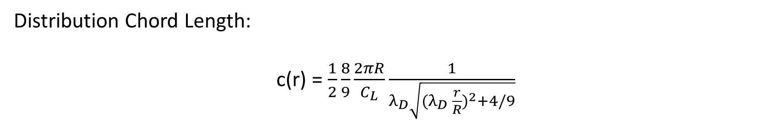
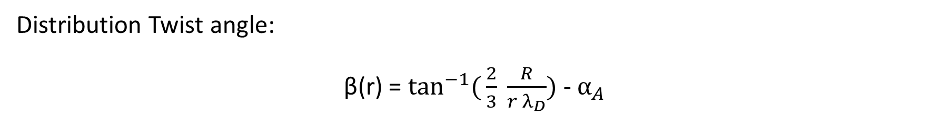
1. Tasks, Script and Output
Distribution Twist angle:
β(r) = $\tan^{−1}({\frac{2}{3} \frac{R}{r λ_{D}})}$ - $α_{A}$
Distribution Chord Length:
c(r) = $\frac{1}{2}\frac{8}{9}\frac{2πR}{C_{L}}\frac{1}{λ_{\begin{aligned}D \\ \end{aligned}}\sqrt{{(λ_{\begin{aligned}D \\ \end{aligned}} \frac{r}{R})}^{2}+4/9}}$

Slide 7
1. Tasks, Script and Output
Script :
63. def Distrubution_Twist_Angle(R,r, Lamda_D, Alfa_A):
64. return math.degrees(math.atan((2/3) * (R / (r * Lamda_D)))) - Alfa_A
65. # Define Loops for repait r values
66. result_Distrubution_Twist_angle = []
67. for r in r_values:
68. result_D_T_A = Distrubution_Twist_Angle(R, r, Lamda_D, Alfa_A)
69. print(f"For r = {r}: Result = {result_Distrubution_Twist_angle}")
result_Distrubution_Twist_angle.append(result_D_T_
print(result_Distrubution_Twist_angle)
---------------------------------------------------------------------------------------------------
# Define function Chord Length
def Chord_Length(R,r, Lamda_D, Z, CL):
return (1/Z) * (8/9) * ((2 * math.pi * R)/CL) * (1/ (Lamda_D * ((Lamda_D * (r/R))**2 + (4/9) )** (1/2)))
result_Chord_Length = []
for r in r_values:
r_C_Length = Chord_Length(R, r, Lamda_D, Z, CL)
print(f"For r = {r}: Result = {result_Chord_Length}")
result_Chord_Length.append(r_C_Length)
print(result_Chord_Length)
Define Function of Distribution Twist angle / Chord Length
Loop:
Any r_value left?
Get the value of next r_value
Print result
No
Yes
Output:
[59.462306457237204, 41.97493401088199, 30.753995929541922, 22.05059700708612, 15.734104734616874, 11.73875855842764, 9.00821226687864, 7.032191945895814, 5.539183728628229, 4.372837573824077, 3.4372357022852, 2.6704481043120047, 2.030779954414248, 1.4891663959275574, 1.097489986081471, 0.8165179873501573, 0.5602219024525228]
[22.430582895204765, 18.1735142241734, 14.525438337673771, 11.305436787606341, 8.80097374635135, 7.159683739189276, 6.017463537827824, 5.18219810960926, 4.546960757775722, 4.048539960826194, 3.647501845374648, 3.3180946102827256, 3.042839949409356, 2.809481131610511, 2.640566392625111, 2.5193176742611656, 2.4086645178811623]
Final result of Distribution twist angle/ Chord Length
Exported value for Exercise_01 excel file

Slide 8
1. Tasks, Script and Output
Script
83. # Read Exercise_01 excel file
84. Exercise_01 = pd.read_excel('C:/Users/s/Desktop/VS_Codes/Aerodynamic/Exercise01.xlsx’)
85. print (Exercise_01)
86. # Chord length values are being exported for Exercise_01 excel file
87. for j in range(len(result_Chord_Length)):
88. Exercise_01.iloc[0 + j, 1] = result_Chord_Length[j]
89. # Distrubution Twist angle values are being exported for Exercise_01 excel file
90. for k in range(len(result_Distrubution_Twist_angle)):
91. Exercise_01.iloc[0 + k, 3] = result_Distrubution_Twist_angle[k]
92. print (Exercise_01)
93. # Updated Values back to the original Excel file (Exercise01_copy)
94. Exercise_01.to_excel('C:/Users/s/Desktop/VS_Codes/Aerodynamic/Exercise01_copy.xlsx')
Update Excel file:
0 2.8667 22.430583 3.542 59.462306 13.308
1 5.6000 18.173514 3.854 41.974934 13.308
2 8.3333 14.525438 4.167 30.753996 13.308
3 11.7500 11.305437 4.557 22.050597 13.308
4 15.8500 8.800974 4.652 15.734105 11.480
5 19.9500 7.159684 4.458 11.738759 10.162
6 24.0500 6.017464 4.249 9.008212 9.011
7 28.1500 5.182198 4.007 7.032192 7.795
8 32.2500 4.546961 3.748 5.539184 6.544
9 36.3500 4.048540 3.502 4.372838 5.361
10 40.4500 3.647502 3.256 3.437236 4.188
11 44.5500 3.318095 3.010 2.670448 3.125
12 48.6500 3.042840 2.764 2.030780 2.319
13 52.7500 2.809481 2.518 1.489166 1.526
14 56.1667 2.640566 2.313 1.097490 0.863
15 58.9000 2.519318 2.086 0.816518 0.370
16 61.6333 2.408665 1.419 0.560222 0.106
Import excel file (Exercise01)
Read Data:
File name: Exercise01
Distribution twist angle/ Chord Length values are exported on Excel file
Output:
r Chord Betz Chord NREL Twist Betz Twist NREL
0 2.8667 NaN 3.542 NaN 13.308
1 5.6000 NaN 3.854 NaN 13.308
2 8.3333 NaN 4.167 NaN 13.308
3 11.7500 NaN 4.557 NaN 13.308
4 15.8500 NaN 4.652 NaN 11.480
5 19.9500 NaN 4.458 NaN 10.162
6 24.0500 NaN 4.249 NaN 9.011
7 28.1500 NaN 4.007 NaN 7.795
8 32.2500 NaN 3.748 NaN 6.544
9 36.3500 NaN 3.502 NaN 5.361
10 40.4500 NaN 3.256 NaN 4.188
11 44.5500 NaN 3.010 NaN 3.125
12 48.6500 NaN 2.764 NaN 2.319
13 52.7500 NaN 2.518 NaN 1.526
14 56.1667 NaN 2.313 NaN 0.863
15 58.9000 NaN 2.086 NaN 0.370
16 61.6333 NaN 1.419 NaN 0.106
Copy Excel file

Slide 9
1. Tasks, Script and Output
d) Compare your value to the ones from the NREL design.
Plotting
Script
96. # Plotting Comparison of chord Length
97. plt.figure()
98. graph = sns.lineplot(x= 'r',y= 'Chord Betz', data = Exercise_01, color = 'Orange', marker = 'o', label = 'Chord Betz’)
99. graph = sns.lineplot(x= 'r',y= 'Chord NREL', data = Exercise_01, color = 'Yellow', marker = 'o', label = 'Chord NREL’)
100. plt.xticks([2.87,5.60,8.33,11.75,15.85,19.95,24.05,28.15,32.25,36.35,40.45,44.55,48.65,52.75,56.17,58.90,61.63])
101. plt.title('Comparison Chord Length’)
102. plt.xlabel('r’)
103. plt.ylabel('Chord Length’)
104. plt.legend()
105.
106. # Plotting Comparison of Twist angle
107. plt.figure()
108. graph_2 = sns.lineplot(x= 'r',y= 'Twist Betz', data = Exercise_01, color = 'Orange', marker = 'o', label = 'Twist Betz’)
109. graph_2 = sns.lineplot(x= 'r',y= 'Twist NREL', data = Exercise_01, color = 'Yellow', marker = 'o', label = 'Twist NREL’)
110. plt.xticks([2.87,5.60,8.33,11.75,15.85,19.95,24.05,28.15,32.25,36.35,40.45,44.55,48.65,52.75,56.17,58.90,61.63])
111. plt.title('Comparison Twist Angle’)
112. plt.xlabel('r’)
113. plt.ylabel('Twist Angle’)
114. plt.legend()
115. # Show the plot
116. plt.show()
End

Slide 10
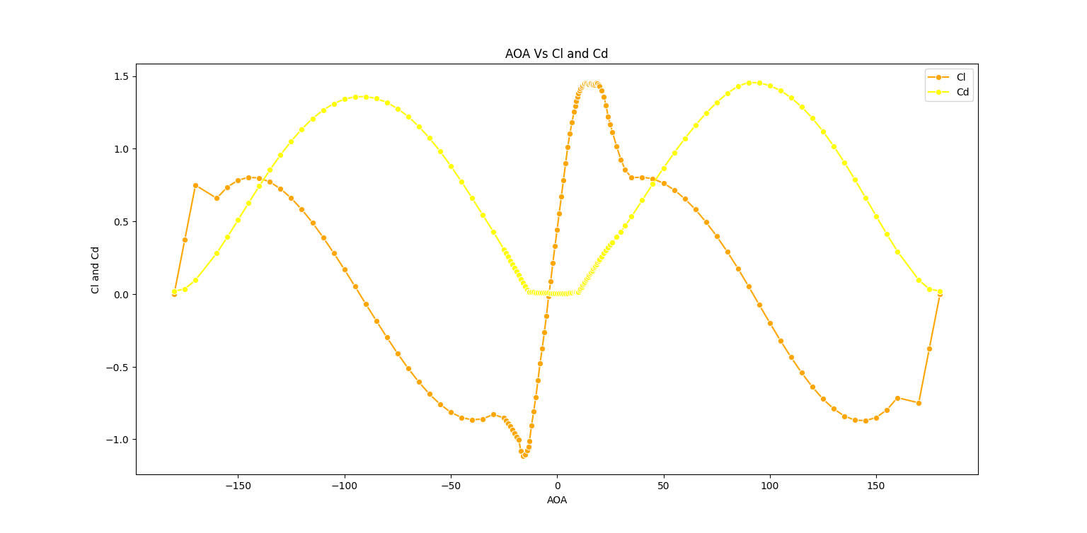
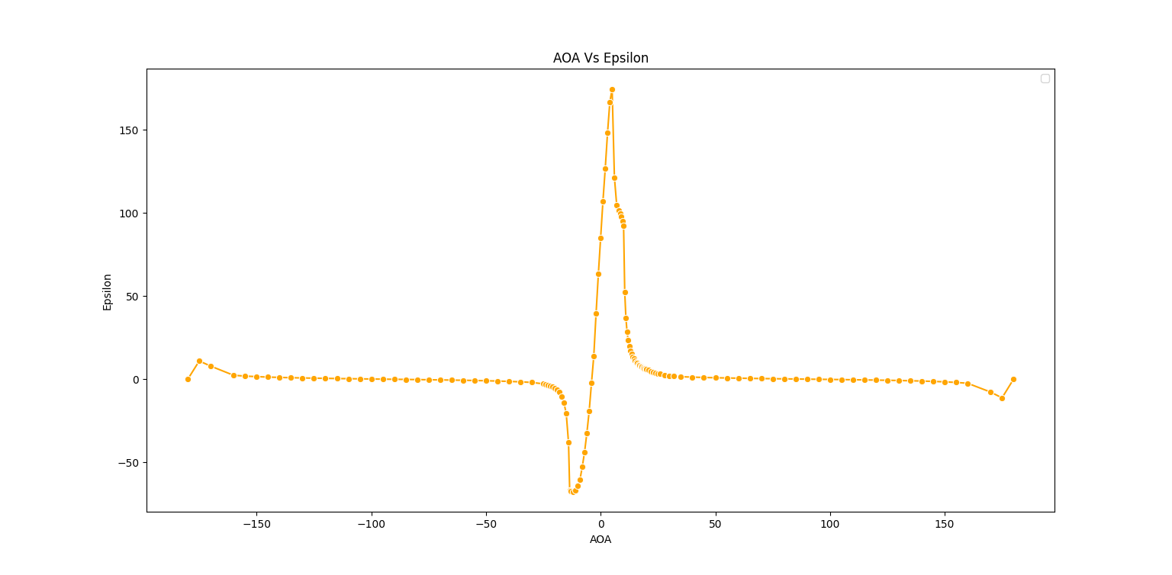
5.Results

Slide 11
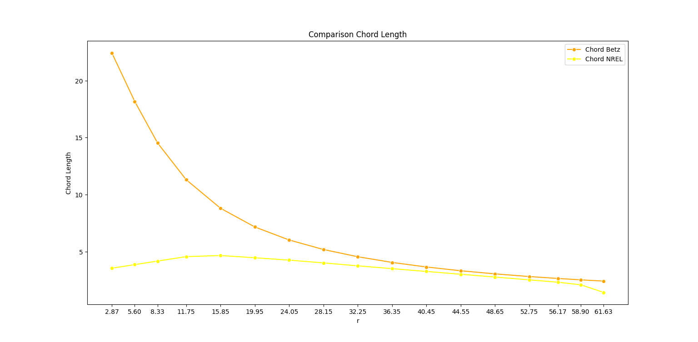
5.Results

Slide 12
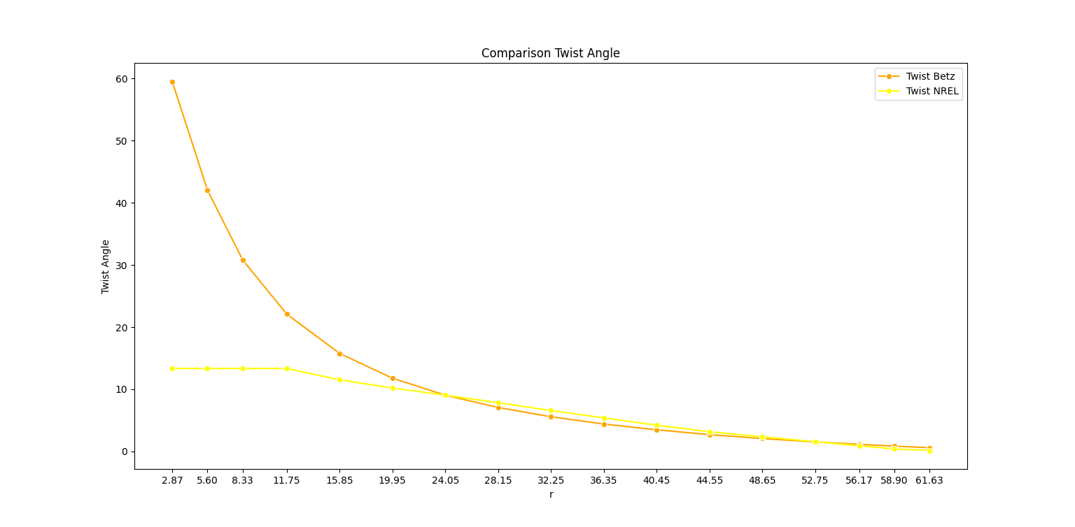
5.Results

Slide 13
6. References
Prof. Dr.-Ing. David Schlipf. “Lecture #1 Introduction to Wind Turbine Aerodynamics” [Lecture notes]. 25.03.2024.
J. Jonkman, S. Butterfield, W. Musial, and G. Scott. Definition of a 5-MW Reference Wind Turbine for Offshore System Development. NREL, 2009.
Python Software Foundation. The Python Standard Library. From https://docs.python.org.
Prof. Ragunathan Rengasamy. “ Python for Data science, IIT Madras “ [Online Lecture]. https://nptel.ac.in.
Temesgen Batu & Hirpa G. Lemu(2020):Comparative Study of the Effect of Chord Length Computation Methods in Design of Wind Turbine Blade. Springer (((LNEE,volume 634)) https://link.springer.com/chapter/10.1007/978-981-15-2341-0_14
Mustafa Alaskari, Oday Abdullah & Mahir H. Majeed (2019): Analysis of Wind Turbine Using QBlade Software. Conference Series Materials Science and Engineering https://www.researchgate.net/publication/333661636

